Slide 1

Final Project & Findings for UFC Data
By: Matthew Nathaniel Olivo

Slide 2
Main Predictors behind winning fights?
Does Stance Play a role in how many wins?
Which fighting styles are best?

Slide 3
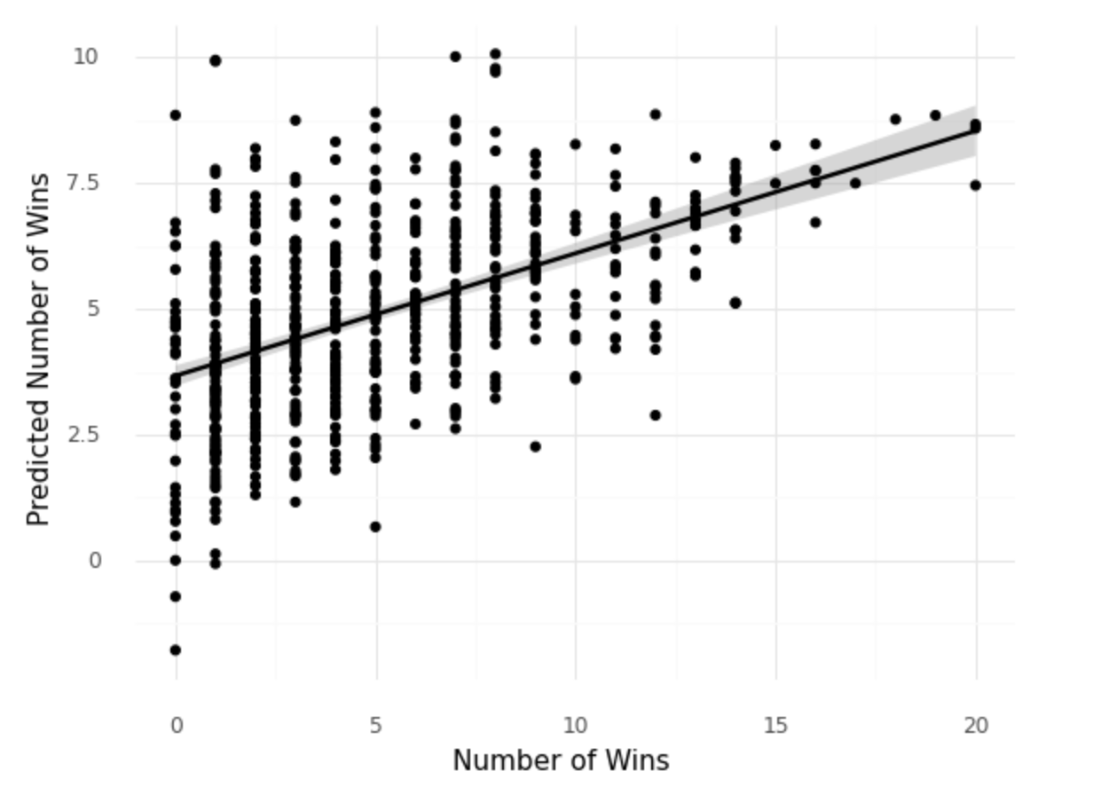
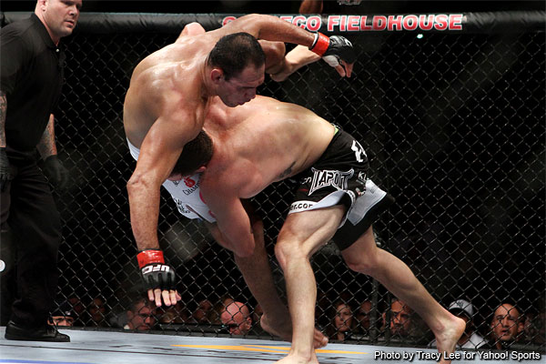
MSE – 10.858
Main Predictors – Age, Average head strikes attempted, Average take downs landed

Slide 4
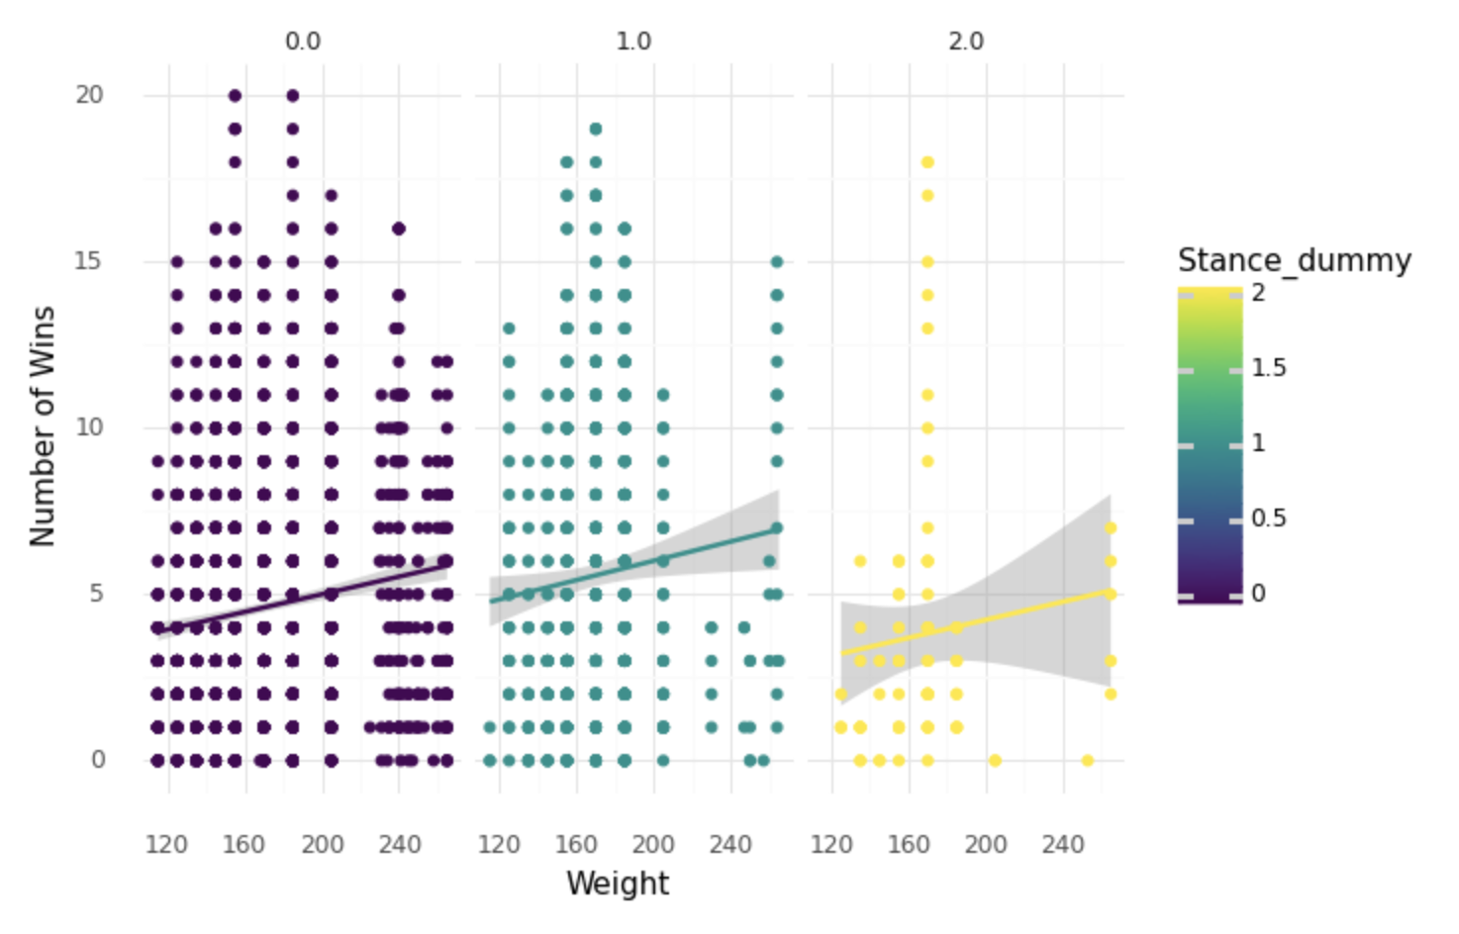
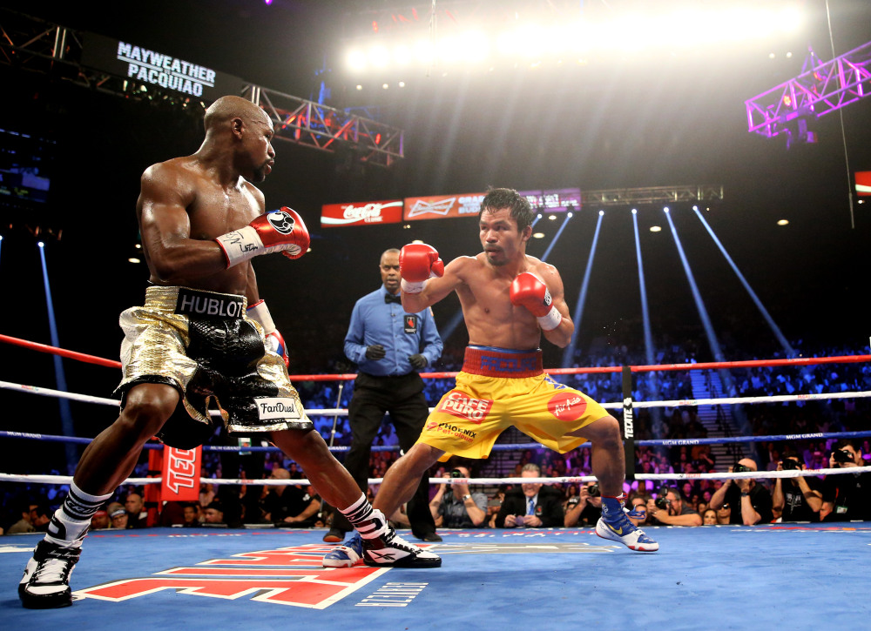

Slide 5
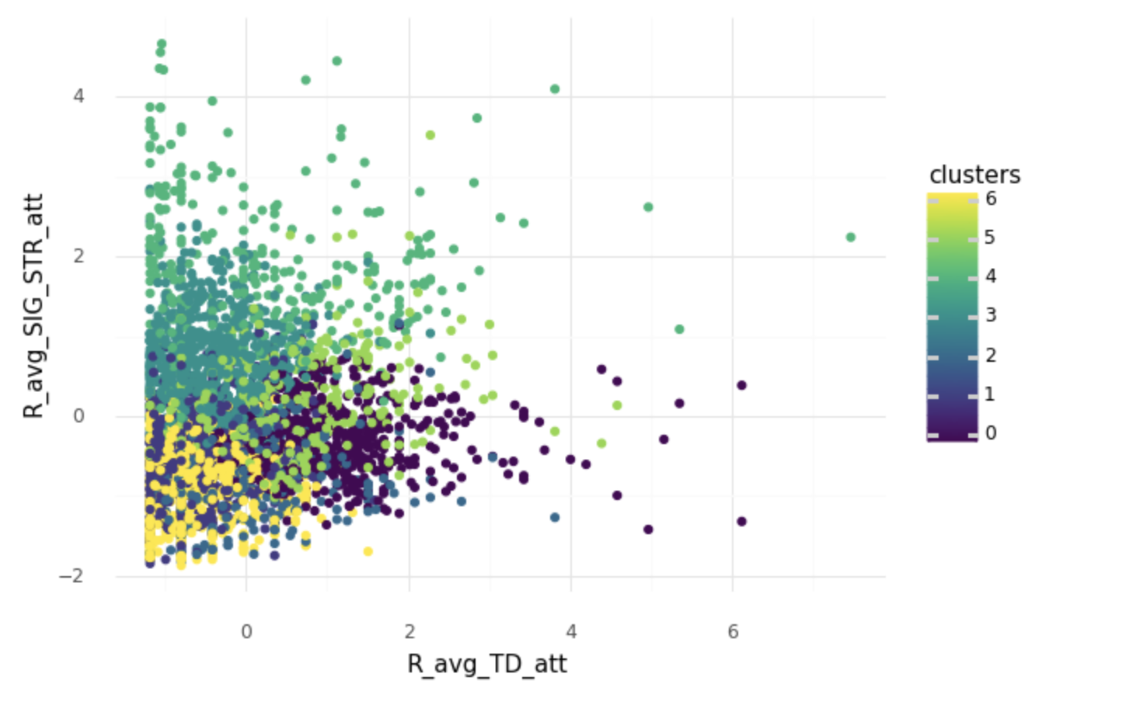

Slide 6
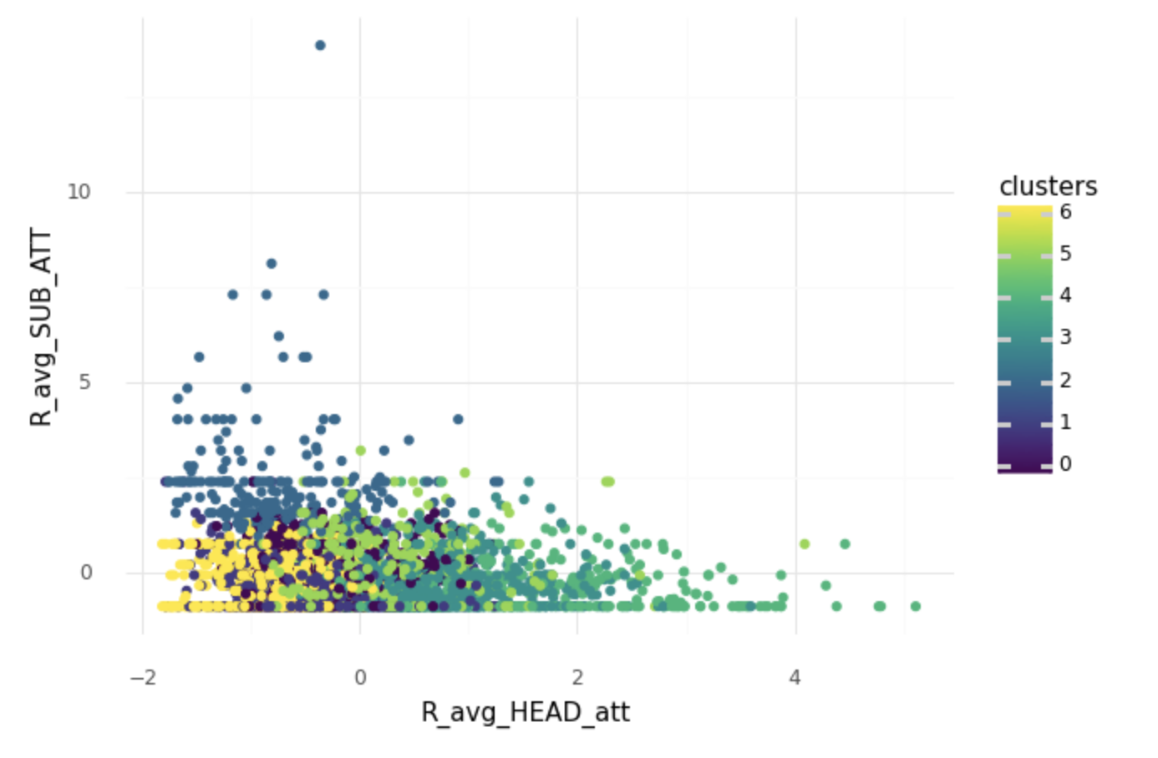

Slide 7
Conclusion

